Slide 1
Rapid Assessment Partner Training
Kootenai county office of emergency management

Slide 2
Welcome
Sandy Von Behren
Manager
Kootenai County Office of Emergency Management

Slide 3
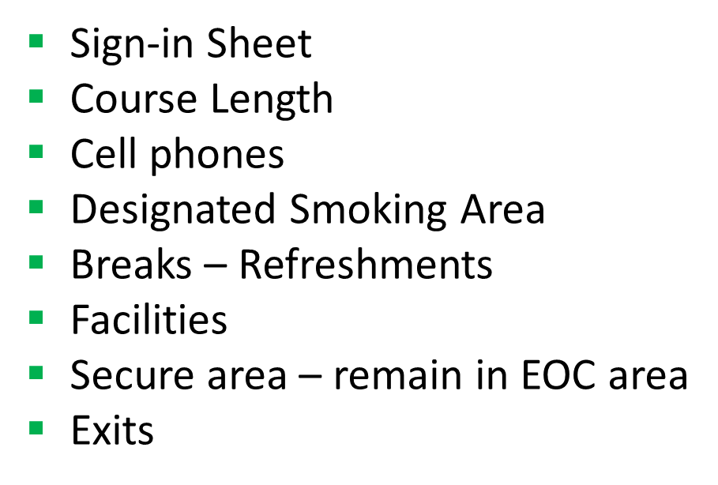
Housekeeping Items

Slide 4
Introductions
Name
Agency
Position

Slide 5
Rapid Assessment
What is it?
Who needs to be involved in it?
How it will help your community?
Why is the same format for submitting information important?
Who needs to receive the assessment information?
Procedures for submitting Rapid Assessment information.

Slide 6
How it will help your community?
The information provided from assessments
Assists in the direction of emergency response
Assists in determining the needs of the survivors
Assists in identifying the need for additional resources
Assists in establishing an estimated dollar value of the losses

Slide 7
What is it?
It is quick
Often called a windshield assessment
It is immediate
- as soon as safe to enter damaged area
- within 36 hours of event

Slide 8
Who needs to be involved in it?
The County will deploy teams to assess the damage in the
unincorporated areas
Municipalities will conduct assessments within their jurisdictions
Other private/public sector entities will assist in assessments

Slide 9
The best source of assessment personnel
Those who perform daily functions in the field
Maintaining our streets and roads
Managing our municipal infrastructure
Sustaining our vital services
Overseeing the power and communication structures

Slide 10
Rapid Assessment
Includes
Public infrastructure
- roads
- public buildings
- bridges
Privately-owned infrastructure
- houses
- businesses

Slide 11
Why is the same format for submitting information important?
All information is collected by the Office of Emergency Management
Assimilated into a prescribed workbook for delivery to Idaho Bureau of
Homeland Security
Information on assessments provided to
- County Commissioners
- Incident Commanders
- Municipalities
- Key Decision Makers

Slide 12
Consistent formatted information
During disaster recovery, time may be critical:
Easier to assimilate
Provides the same information from all assessment personnel
Allows for faster distribution of information

Slide 13
Remember
This information may help determine:
What is needed?
When is it needed?
Where it is needed?
How much is needed?
For how long will it be needed?

Slide 14
Who needs to receive the assessment information?
One collection site:
The Office of Emergency Management or
Emergency Operations Center, if activated

Slide 15
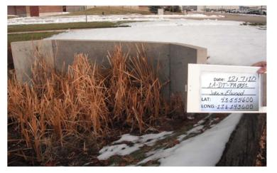
Procedures to submit Rapid Assessment information.
Public Infrastructure
1. Use a standard camera with the Damaged Site Data/Location Form
and GPS device if not in camera:

Slide 16
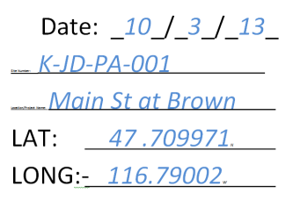
Damaged Site Data/Location Form
Must include
Date
Labeling
K – for Kootenai
JD – photographers initials
PA – public assistance
Picture Number of Site
Brief description
Latitude
Longitude

Slide 17
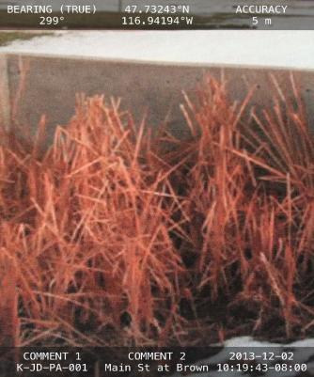
Or use an electronic device (I-Phone, Android,
tablet) with an application that provides date,
time, latitude, longitude, photographer’s name
and brief location

Slide 18
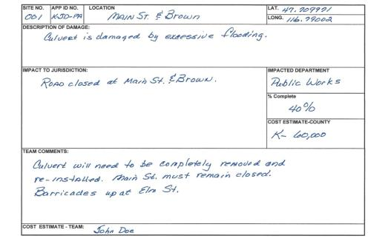
2. Fill out as much as possible on the Field Form while in the field.
During Rapid Assessment,
limited information may be available. Complete only information known at time.
Note: If using an electronic device, include this information in the email and
attach the picture

Slide 19
Fax, Email, on deliver on thumb drive to the Office of Emergency Management or
Emergency Operations Center, if activated

Slide 20
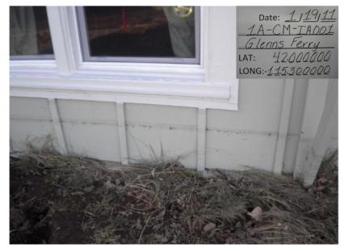
Procedures to submit Rapid Assessment information.
Private Structures (Individual):
Use a standard camera with the
Damaged Site Data/Location Form
and GPS device if not in camera:

Slide 21
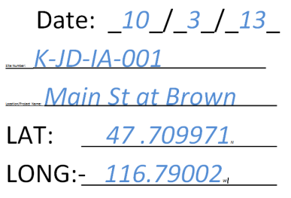
Damaged Site Data/Location Form
Must include
Date
Labeling
K – for Kootenai
JD – photographers initials
IA – individual assistance
Picture Number of site
Brief description
Latitude
Longitude

Slide 22
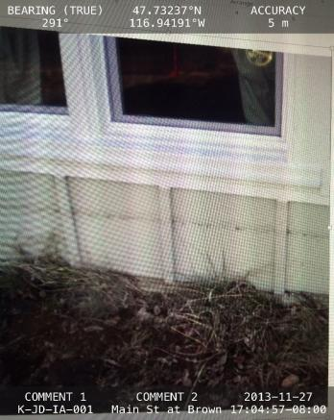
Or use an electronic device (I-Phone, Android,
tablet) with an application that provides date,
time, latitude, longitude, photographer’s name
and brief location

Slide 23
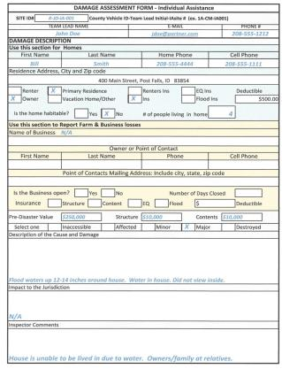
Fill out as much as possible on the Damage Assessment for Individual Assistance Form
while in the field.
During Rapid Assessment,
most of this information may not be available. Complete only information known at time.

Slide 24
Fax, Email, on deliver on thumb drive to the Office of Emergency Management or
Emergency Operations Center, if activated

Slide 25
Questions
Sandy Von Behren, Manager
Kootenai County Office of Emergency Management
5500 North Government Way
Post Office Box 9000
Coeur d’Alene, Id 83816-9000
Phone: (208) 446-1775
Fax: (208) 446-1780
Email: kcoem@kcgov.us

